Slide 1
Promoting Critical Thinking, Reading and Writing in the Classroom

Slide 2
Background
Survey course on Western Civilization
Expectations:
Familiarity with foundational texts in Western literature from ancient times to the Renaissance
Developing critical thinking, reading, and writing skill
What this course does:
Critically analyze the construction of the West and its others, that is, it’s about monsters!

Slide 3
Warning! The Content of this Course May Challenge Your Worldview…
And that’s precisely the goal:
“…[A]s Shoshana Felman (1995) suggests, educators should expect students to enter crisis. In fact, she argues that “teaching in itself, teaching as such, takes place precisely only through crisis” (p. 55). How so? Consider the difference between education and repetition. “Education” is not about repeating what we already know, or affirming what we already believe, or reinforcing what we previously learned. That is merely repetition. Education is about learning something new, something different; education is about change. …[E]ducation—especially the process of learning something that tells us that the very ways in which we think and do things is not only wrong but also harmful—can be a very discomforting process. Hence the notion that learning takes place “only through crisis” (115).
Kumashiro, Kevin K. “Teaching and Learning Through Desire, Crisis, and Difference: Perverted Reflections on Anti-oppressive Education.” Controversies in the Classroom: A Radical Teacher Reader. New York: Teachers College P, 2008. Ed. Joseph Entin, Robert C. Rosen, and Leonard Vogt. New York: Teachers College P, 2008. 113-125.
“What is taught in the classroom can have a positive effect in interrupting stereotypes and assumptions about ethnic groups. Painting a more accurate picture of what is happening in the world and understanding the complexity of issues such as terrorism, immigration, and cultural difference are integral to achieving this goal” (30).
Verma, Rita. Controversies in the Classroom: A Radical Teacher Reader. New York: Teachers College P, 2008. Ed. Joseph Entin, Robert C. Rosen, and Leonard Vogt. New York: Teachers College P, 2008.

Slide 4
Challenges
Adjusting to college life / expectations
Students’ misconceptions about the texts (the influence of visual media) [see images]
Familiar yet chronologically and geographically distant
Students usually struggle with critical thinking, reading, and writing

Slide 5
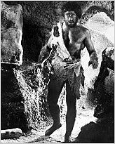
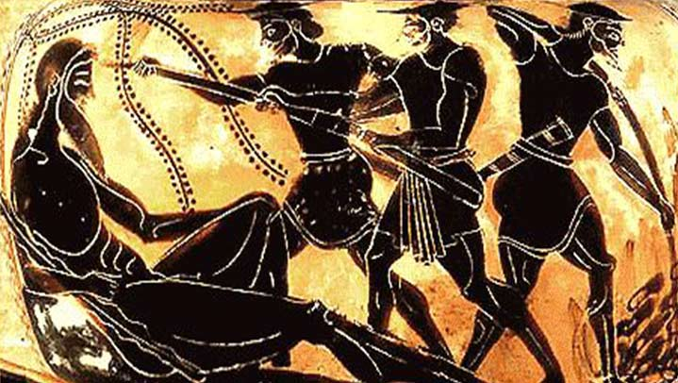

Slide 6
Strategies
The use of a connecting theme
Introduction to some literary yet not exclusively literary conventions:
Sympathetic reading vs. critical reading
“The implied author," "the postulated reader," and "the unreliable narrator“ (Wayne C. Booth, The Rhetoric of Fiction, 1961)
Laura Mulvey’s “male gaze”
Introduction to critical theory
Othering, orientalism, the contact zone, stereotyping, etc.
Three steps:
Brainstorming
Close reading
Reflective writing

Slide 7
Case example: The Odyssey
Hospitality (or its transgression) is at the core of the Trojan war, from which Ulysses is returning in The Odyssey.

Slide 8
Activity 1: Brainstorming
Take a couple of minutes to reflect on what hospitality means to you (what a hypothetical host and a hypothetical guest are expected to do and how they are expected to behave). Write down your reflections.
When you are ready, write your conclusions on the white sheet on the wall.

Slide 9
According to the OED:
NOUN
1‘Scotland is renowned for its hospitality’
SYNONYMS
friendliness, hospitableness, welcome, warm reception, helpfulness, neighbourliness, warmth, warm-heartedness, kindness, kind-heartedness, congeniality, geniality, sociability, conviviality, cordiality, amicability, amenability, generosity, liberality, bountifulness, open-handedness
ANTONYMS
unfriendliness
2‘the inn's hospitality includes a selection of real ales, bar menu, and live music on Thursday nights’
SYNONYMS
entertainment, catering, food, accommodation
For the Ancient Greek hospitality or xenia consisted of two basic rules:
The respect from host to guest. The host must be hospitable to the guest and provide him/her with food, drink, bath and gifts when they leave. It is not polite to ask questions until the guest has finished the meal provided to them.
The respect from guest to host. The guest must be courteous to the host and not be a burden. The guest should also provide a gift if they have one
Host / guest are the same thing in some languages

Slide 10
Close-reading prep
What happens in this episode? (summary)
Who is the guest and who is the host?
Where and how does (or does not) hospitality happen in the text?
For the close-reading itself:
Who is speaking? (point of view)
Pay attention to the words (nouns, adjectives, verbs) used in the passage.
Pay attention to the structure of the passage. Are there any repetitions?
What are the key ideas of this passage?

Slide 11
Activity 2: Close-reading
“From there we sailed with heavy hearts, and came to the land of the Cyclopes, a lawless, aggressive people, who never lift their hands to plant or plough, but rely on the immortal gods. Wheat, barley, and vines with their richly clustered grapes, grow there without ploughing or sowing, and rain from Zeus makes them flourish. The Cyclopes have no council meetings, no code of law, but live in echoing caves on the mountain slopes, and each man lays down the law to his wives and children, and disregards his neighbours.
”A fertile island lies slantwise outside the Cyclopes’ harbour, well wooded and neither close to nor far from shore. Countless wild goats inhabit it, since there is nothing to stop them, no hunters to suffer the hardship of beating a path through its woods, or to roam its mountaintops. There are no flocks, and no ploughed fields: but always unsown, and untilled it is free of mankind and nurtures only bleating goats. The Cyclopes have no vessels with crimson-painted prows, no shipwrights to build sound boats with oars, to meet their need and let them travel to other men’s cities, as other races visit each other over the sea in ships, no craftsmen that is who might also have turned it into a fine colony. For this island is by no means poor, but would carry any crop in due season. There are rich well-watered meadows there, along the shore of the grey sea, where vines would never fail. There is level land for the plough with soil so rich they could reap a dense harvest in season. And there’s a safe harbour where there’s no need for moorings, neither anchor stones nor hawsers: you can beach your ship and wait till the wind is fair and the spirit moves you to sail.”

Slide 12
Activity 3: Reflective Writing
What did you learn about the encounter between Odysseus and the Cyclops? To what extent is this episode representative (or not) of hospitality? What does this episode tell us about representation / monsters?

Slide 13
Q & A

